Slide 1
GoCloud HTML & CSS
Part 3

Slide 2
For this version of the GoCloud site, we will repeat some of the techniques from before, but add a few more.
This one will have a horizontal navigation and three columns in a grid layout.

Slide 3
This is the wireframe we will be using for this design.
Here are the main sections:
1. Header
2. Navigation
3. A row with three columns
4. A second row with three columns
5. A footer.
All of this is inside a container set to 900 pixels wide. Let's get the html in place for the structure.

Slide 4
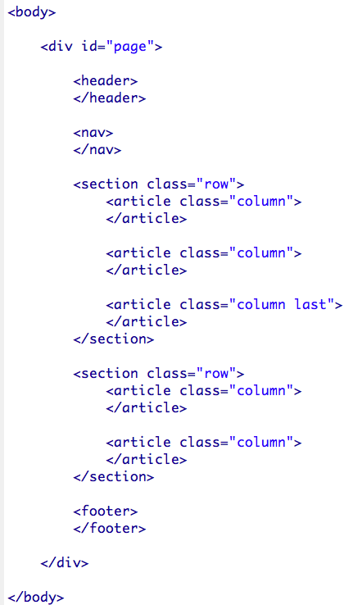
Here is the basic structure of the HTML we will be using.
You can see there is the header, followed by the navigation section. Then there is a <section> element with a class set to "row". Inside that section are three <article> elements with a class set to "column". The last column has a class of "last" on it as well. More about that in a bit.
There is another row with two columns followed finally, by the footer.
All of this is inside a div with an ID of "page".

Slide 5
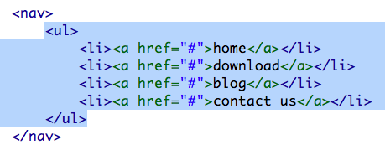
We can add the image in the header from our images folder.
Inside the <nav> element, we can add the unordered list for our navigation. This is pretty much exactly what we had in our previous version of the site.
Also, we can include the content for each element in our grid design. You will need to pull this from the photoshop file. Finally I put the content in the footer that we had before.

Slide 6
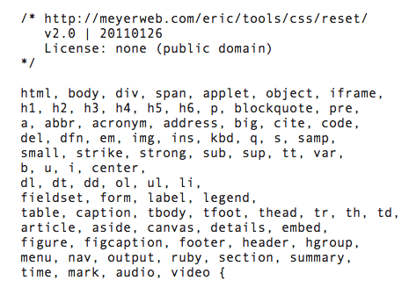
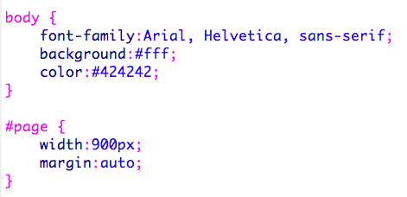
Next, let's connect our stylesheet as we did before. Don't forget to create the file and save it in your folder.
Once you have the stylesheet connected, go back to Eric Meyer's website and get his CSS reset (or get it from the previous project). Here is the link: http://meyerweb.com/eric/tools/css/reset/
After the reset is in place, we can add these basic styles for the page. This is pretty much what we did for the previous design.

Slide 7
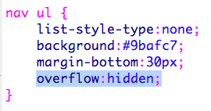
Horizontal navigation can be a bit tricky, until you understand how to make it work properly. Basically, each list item will be floated left. I set the background color of the <ul> element to be the same color as the backgrounds of the <a> elements. There are a few very important techniques to understand to make this work properly.
The first important technique, is to make the <ul> element contain the floated <li> elements. In Part 1, we dealt with this floating issue by putting an element at the end of the floated elements that cleared the floats. Here we have no such element, but if we add the declaration, overflow: hidden, that will do the job.
The list items themselves simply float left.

Slide 8
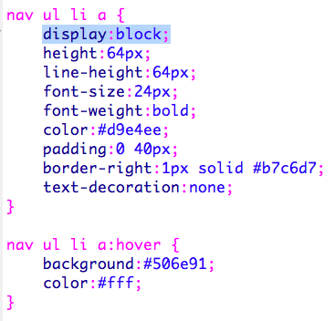
Navigation in list format gives us lots of elements that we can style. We can style each and everyone of these elements: <nav>, <ul>, <li>, and the <a> tag.
Generally, it is best if you put most of the visual styling here on the actual anchor tag (the <a> tag).
So, we set the height, color of text etc. But the really important declaration here is to tell the anchors to display:block.
Anchor tags (<a> tags) by default display inline. Telling them to display as block level items allows you to give them a height, margins, padding and other properties that belong to block level items. Also, it makes it so that entire block is clickable, not just the text itself.
Also worth noting, by setting the height to 64 pixels and the line-height to 64 pixels will put the text in the vertical center of the block.
Finally, I added the hover rule for a little interactivity when the user rolls the mouse over the anchor elements.

Slide 9
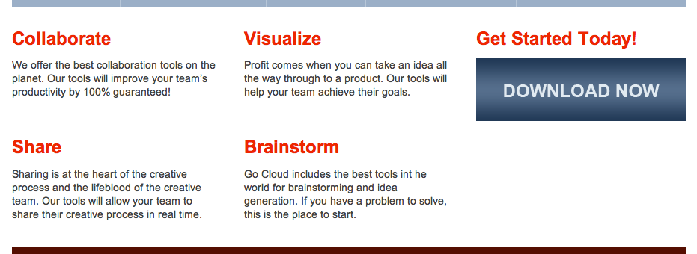
I found that the header was creating a small gap at the bottom, so I set the height to be the same as the image.
This next part could be done in a couple of ways. We could just have three columns, but if we want to make sure the "Share" section and the "Brainstorm" section line up horizontally, we need to put top three in a row and the bottom two in a row. That is exactly how we did it in our code.

Slide 10
The top version has just three columns, but if the amount of copy in any section gets longer, the second row will become misaligned. For that reason, I opted for the version below, where there is a row with three columns in it and a second row with two columns in it (room for a third).

Slide 11
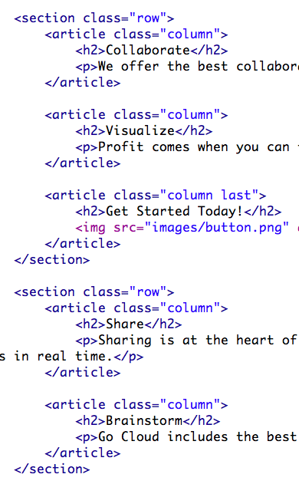
Here is the markup that we created to make the rows and columns. You can see two sections, each with a class of "row" and the top row has three articles in it, each with a class of "column".
The second row has only two columns in it.
Here I have added a rule for the row. Note that because we will be floating the columns inside the row, we need to use the overflow:hidden trick again.

Slide 12
900px
A
B
A
B
A
A + A + A + B + B = 900 pixels
To make the columns fit properly, I need three equal sized columns that have a margin on the right side. The third column gets no margin on the right side. How wide should they be so that everything fits in a 900 pixel wide box?
I came up with a width of 280 pixels for A and 30 pixels for B. 280 x 3 = 840. B x 2 = 60 add them together to get 900.
Ok, let's see how to make this work in CSS.

Slide 13
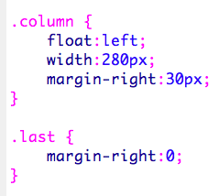
Here I added a rule for the column class, which floats those elements left, sets a width of 280 pixels and puts 30 pixels of margin on the right.
So, how do you remove that margin from the third column? I created a class called "last", which sets the margin on that element to zero.
You may recall that we added a second class of "last" to that third column in the row.
Because in CSS, the final rule that loads wins if there is a conflict, the margin on this final column will be zero.

Slide 14
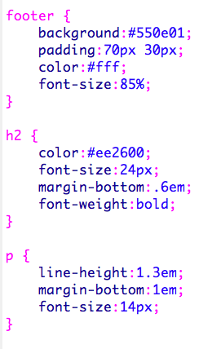
The rest of the styles for the page will simply style the footer and the type elements the way we want, as we did in the first part.
The last thing we should do, is add the HTML5 Shiv to make the page work well for older browsers. Just repeat the steps from the first part.

