Slide 1
GoCloud HTML & CSS
Part 5 - Faux Columns

Slide 2
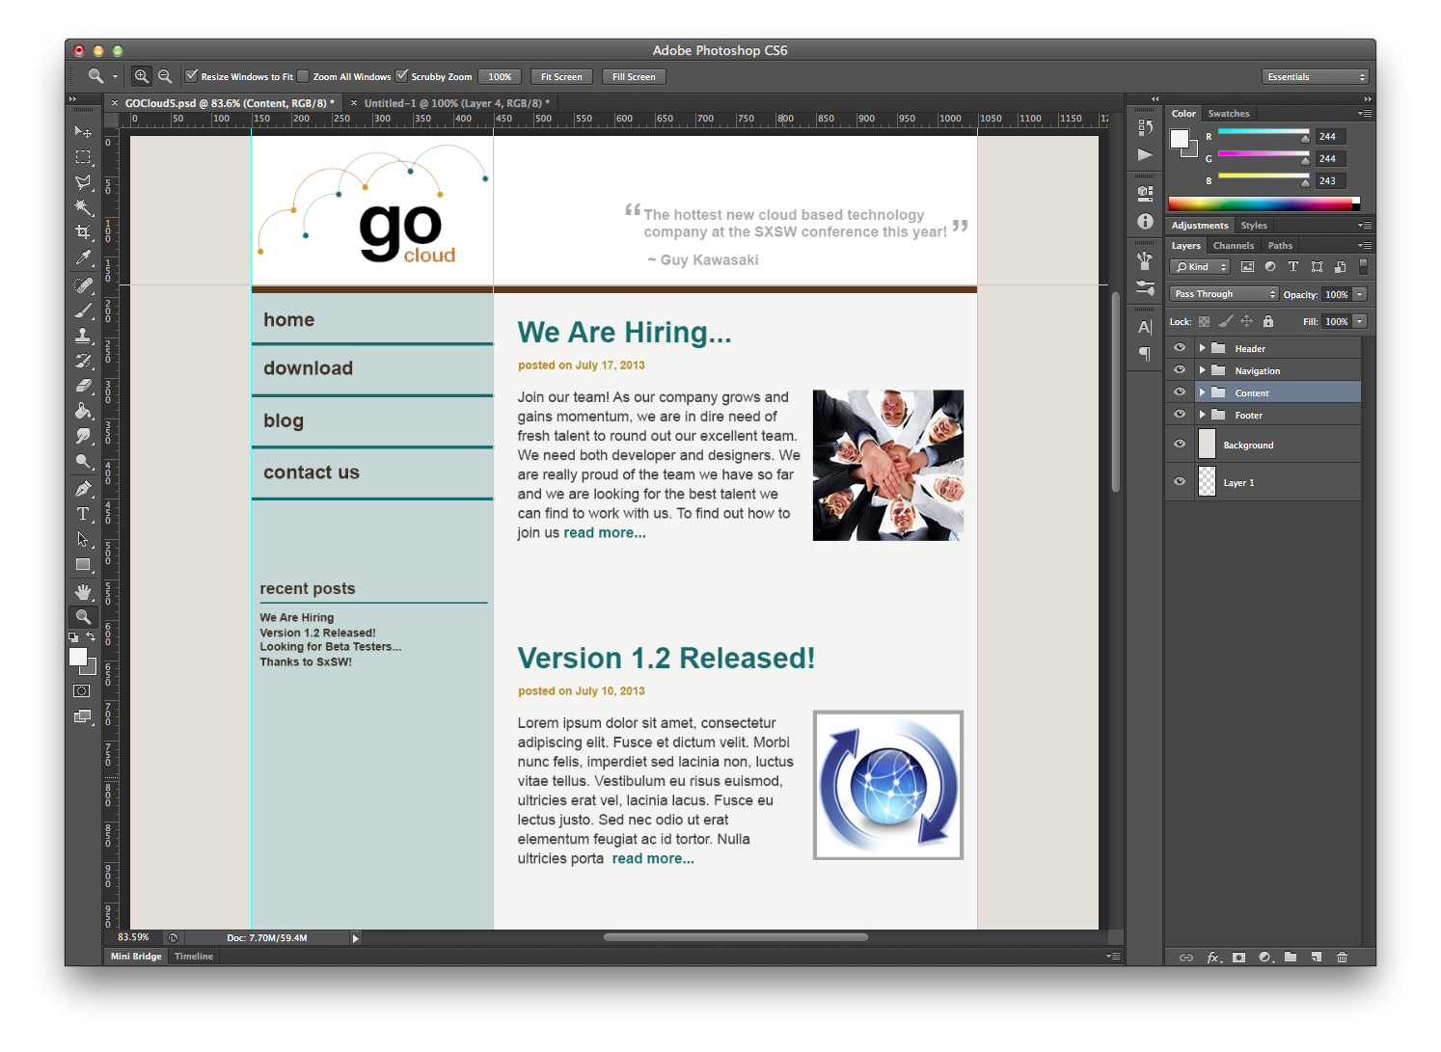
We are going to explore a few important new techniques while creating the HTML / CSS for this version of the GoCloud site, which could perhaps be the blog page.

Slide 3
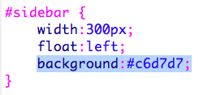
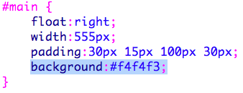
At first this seems simple. We have a sidebar that floats left and a main content that floats right. We give each a background color.
However, you will notice the problem is that when the content area of one is longer than the other the column is visually broken.
When you float an element, the container shrink wraps around the content and no amount of setting height is going to help.
Enter the technique called faux columns. This technique has been used for a long time. As new layout models are developed for CSS and supported by browsers, this technique will fade, but for now, it is still important to know.

Slide 4
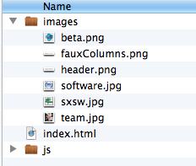
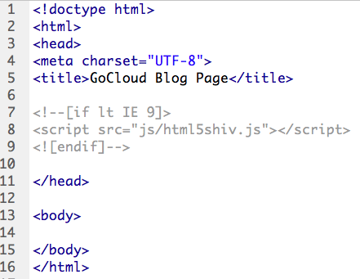
Ok, let's get started with this project. In the start folder you will notice that there is an index.html file, a JS folder and an image folder with the images we need from the project in it. Open the HTML file in DreamWeaver or your editor of choice.
The HTML is just the start of the page, but notice I have included the HTML5 shiv and it is linked already.
There is no css file yet. Let's create that file and link it now.

Slide 5
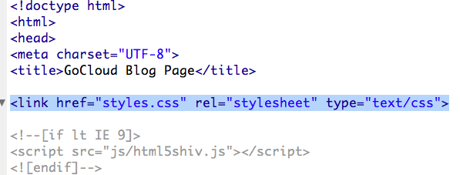
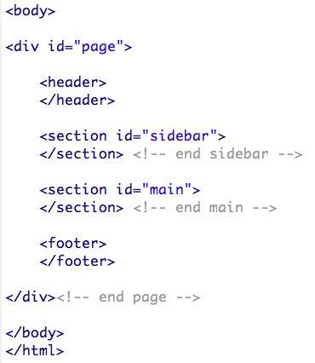
I created a file called styles.css and saved in the folder with my project and then added the link to the HTML file.
On the CSS file, the first thing I added was Eric Meyer's CSS Reset rules. You can go to his site and get it, or I put it in the snipits to make it a little easier for you.
Then, going back to the HTML file, let's get the markup for the structure of our page in place. We have a container called page, a header two sections (one will float left and the other to the right) and a footer.

Slide 6
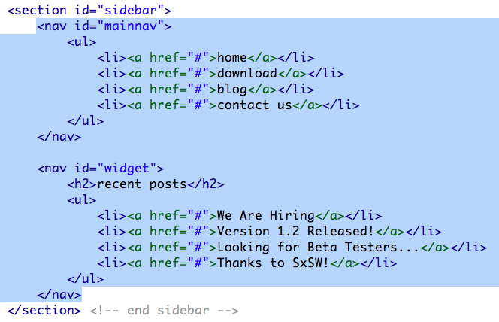
The header just has an image, so I put that in.
The sidebar section gets two nav elements with unordered lists in each one.

Slide 7
The main section is going to get four blog posts. I pulled the content directly from the PSD file. I put the content for the first one in the snipits and then added markup for the other three there as well, to speed up the process.
Finally, I added the markup for the footer.
Now that all our markup is in place, we can start working on the styles.

Slide 8
First, I will make a rule that sets some basics for the whole page in terms of background color, font family, font size and color.
Next, the #page div is set to 900px wide, same as in our PSD file. Margin auto will center the div on the page.
Notice the background image. This is our faux column image that will create columns on the page the way we want.
It is just a one pixel tall, 900 pixel wide image pulled from the PSD file that repeats down the page.

Slide 9
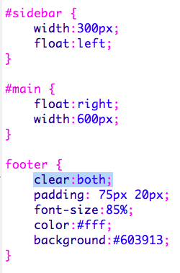
It doesn't look very good yet, but you can see our columns are in place and working properly down the whole page.
Some basic rules to get our sidebar floated left, and the main content floated right. Remember that the footer needs to clear both the left and right floated elements.

Slide 10
Already coming together!
The header should have a 10px brown border on the bottom. Let's add a rule to add that.

Slide 11
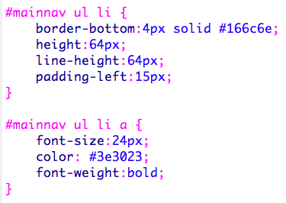
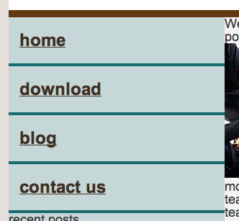
Next, we will style the main navigation on the sidebar. These two rules will make the list items and the links inside them look pretty close to the way we want.
You will notice that they still have underlines. Rather than taking that off in this rule, I am going to set a general rule in a section at the bottom of the stylesheet for typography, since none of the links anywhere on the page have underlines.

Slide 12
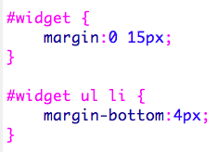
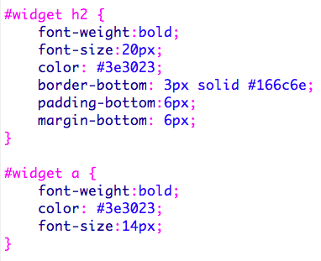
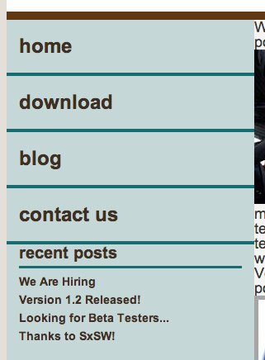
The next rules are for the Recent Posts widget. Then in the type section I added a couple of rules to make the type in that section look the way I want.
That part is looking pretty good, but I want some space between my main nav and the widget. So I added some margin to the bottom of the main nav.

Slide 13
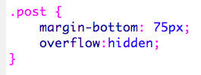
With the sidebar in place, the main section is all that is left to style. First, I want to add some padding. I put 30px on top, 15px on the right, 100px on the bottom, and 30px on the left.
Don't forget that adding padding adds to the width and the height of the element. We don't care about height, because this will stretch to be as high as it needs to, but we care about width. So I have subtract 45px from the 600px width (30px for the left and 15px for the right).
Each blog post is in an article element with the class of post. This rule will add some padding to the bottom of each post and the overflow:hidden declaration will ensure that any images floated inside (which we will do), will be contained by its parent article element.

Slide 14
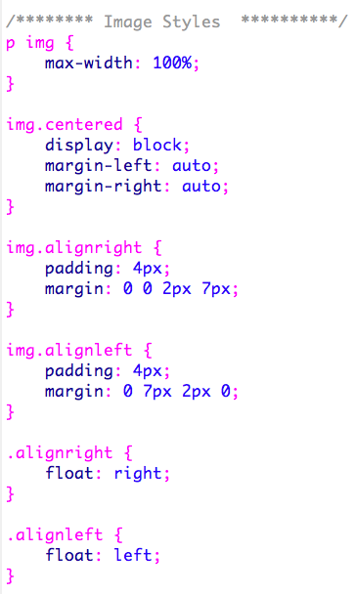
Here are a set of styles that will allow us to have text wrap around our images. We can have images on the left, on the right or centered. Images floated left or right will have text wrap around them. Images that are centered will have text come after them. Try playing with adding or removing the classes from the images in the HTML.

Slide 15
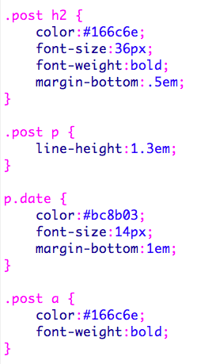
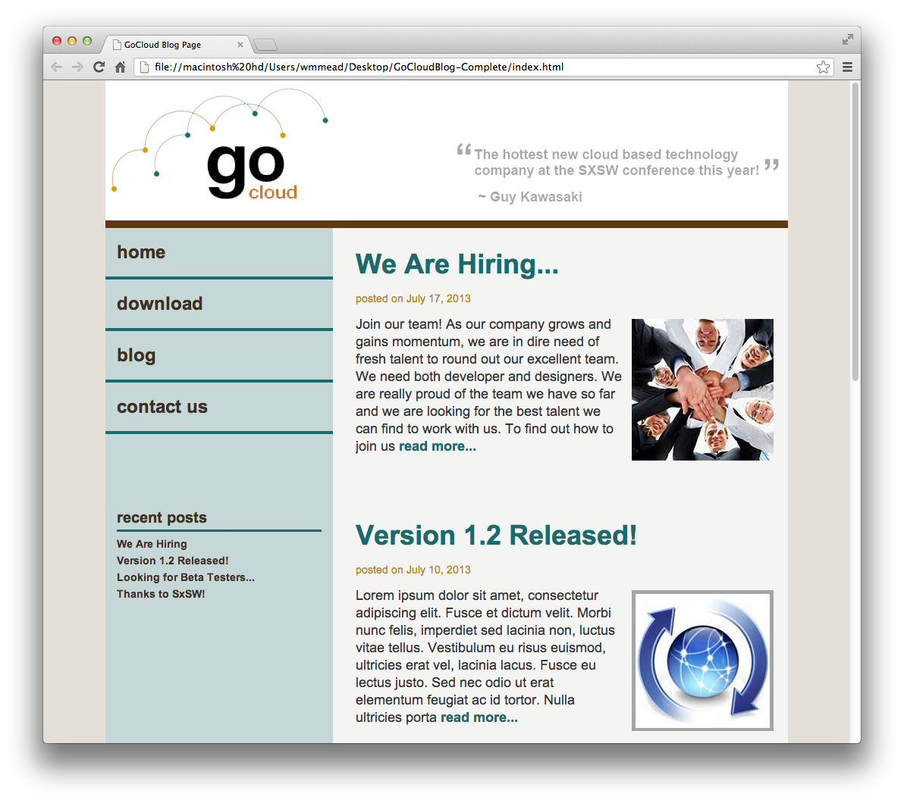
All we have left is to style the type for that section. Here are some rules that will target those items and do the trick.
We have achieved our goal! Along the way we learned about faux columns and how to style images so text will wrap around them.

