Slide 1
Digital Type
Creating a Baseline Grid

Slide 2
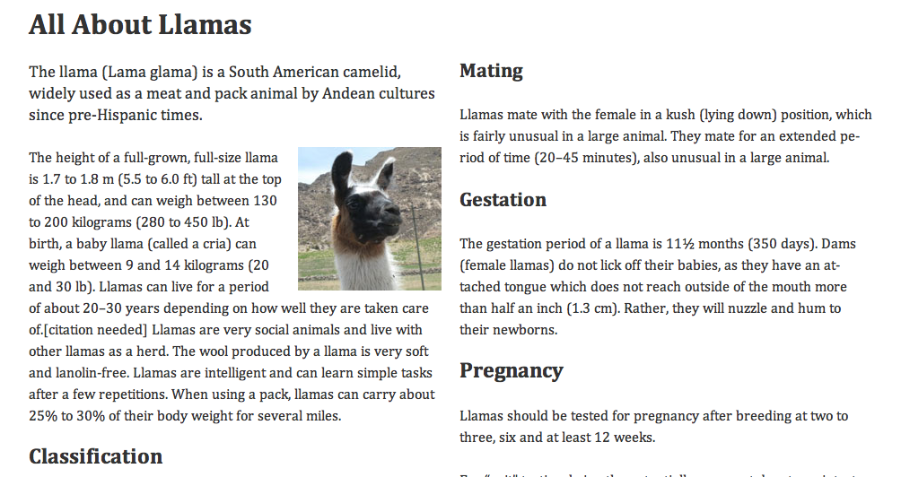
We are going to use our typographic skills to look at some technical ways of building a baseline grid and make use of internal relationships to create a harmonious page. Note that this is really just a starting point. From here, you can add "personality" to the page.

Slide 3
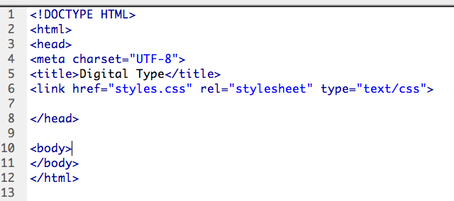
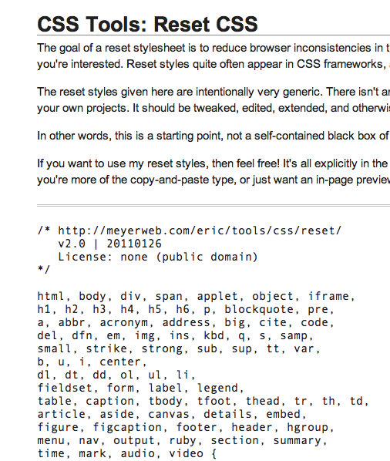
We will start with a simple HTML5 file. There is a style sheet attached, but the style sheet is empty.
The first thing we have to do is get a reset script. I am going to use the famous Eric Meyer CSS reset for this page.
You can find it here: http://meyerweb.com/eric/tools/css/reset/
Or I also put it in the snipits.

Slide 4
Next, I will add some basic settings for the page. At the end, try putting in some different font stacks and see what you get.
About font sizes:
Our reset script is setting the font at 100%, which is about 16px for most browsers. 16px is not the same size for every typeface. It depends a lot on how the designer made the typeface.
Some web designers are moving back to using pixels to define sizes in CSS, but most are using ems (the width of a letter 'm'), and there are still good reasons for using relative sizes for this, as we will see.
If you wanted to use 12 pixel type, you would figure out the ems like this:
16px * 0.75 = 12px.
font-size: 0.75em;
However, according to this article 16px is actually just about right for reading on a screen. So we will leave our sizing at the 100% default size.

Slide 5
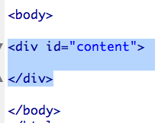
Next I will put a DIV on the page for content and add a few basic styles. The div will be centered on the page and set to 960 pixels wide. We are going to use the popular 960 grid to layout our page because it gives us such easy numbers to work with.
The grid consists of 16 columns, each column is 60 pixels wide with 10 pixels gutter on each side.

Slide 6
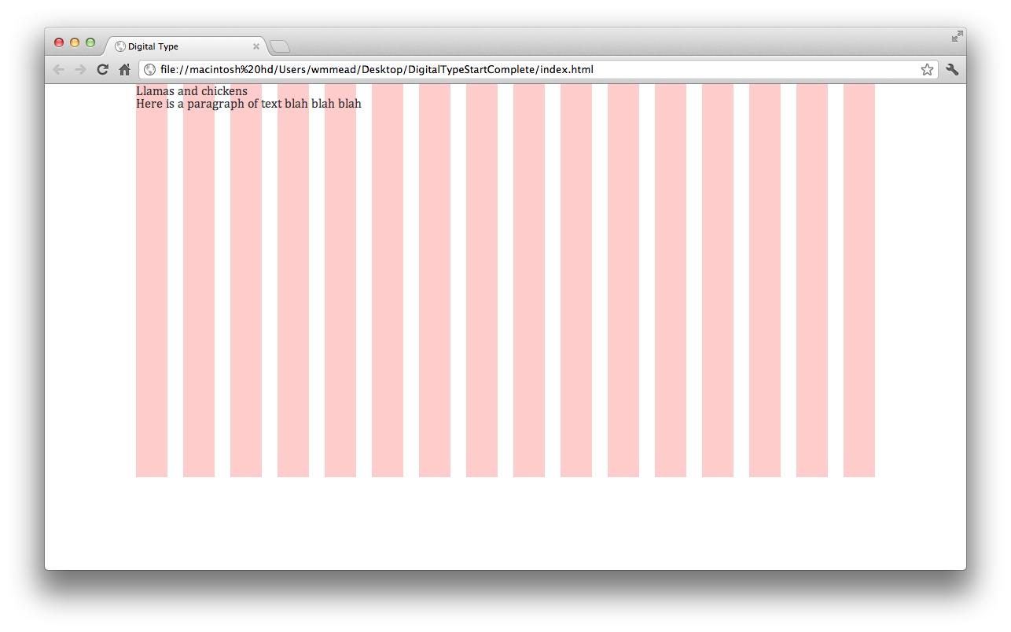
If we add just a little bit of content to our page, you can see how it is lining up with the column on the left.

Slide 7
About Measure
Measure is how long your lines are. 45 to 70 characters long is ideal for reading. We are going to divide our page into two columns in this case, each will consist of 8 of the 16 columns provided by the grid.
The length of the line, combined with the space between lines, sets up a ratio that is important to the reading experience. We are going to use that ratio to determine everything about the way this document looks. We could use complex numbers based on the golden ratio, but for this example we will use easier numbers to work with.
Before we get to that. Let's set up a column.

Slide 8
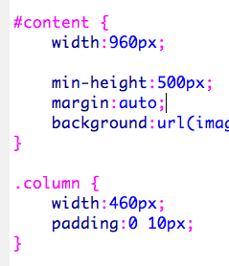
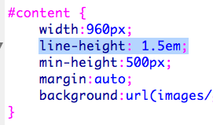
I am going to add the width rule to .column. But I am also going to add the padding to .column and take it out of the content and change the width in content to 960px. You will see if you test the page, that it looks the same. Later we will add a second column.
For the vertical rhythm of the page, I am going to set the line height to 1.5em. This is the same as 24px.
16 * 1.5 = 24
24 is going to be like a magic number for us. We will set everything in relation to this magic number, creating a visual relationship that makes sense.

Slide 9
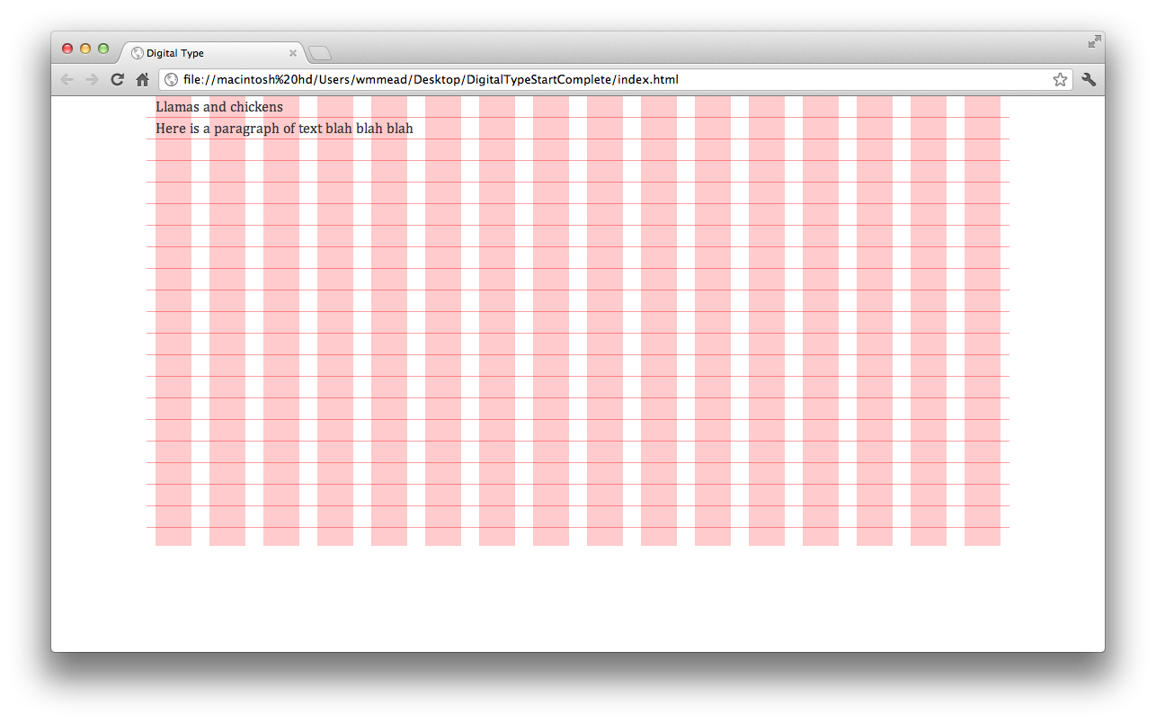
Let's update the grid to show our baselines. There is an image in the folder that is ready to use for this. Just change the '1' to a '2' for the background image and you will see it.
You will notice that the text does not sit right on the baseline. We can fix that by just adjusting the position of the background image a bit.

Slide 10
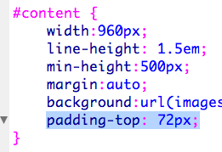
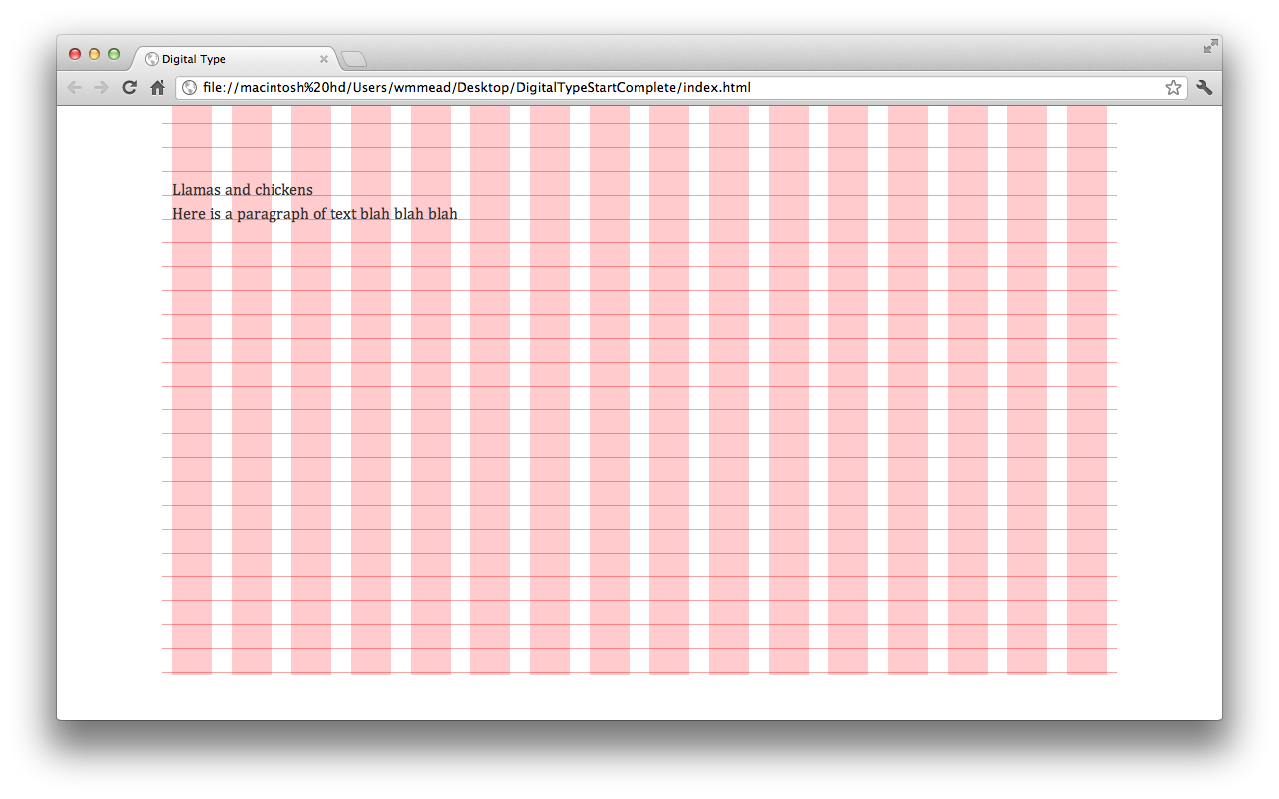
The text sits nicely on the baseline now, but it would be better a little further down the page. I added some padding to the top of the page. Notice 72px is 3 * 24px.

Slide 11
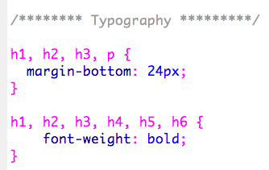
Next, since our reset is setting the sizes of everything down, we need to set some styles for typographic elements. We will start with these. Notice the magic number.
I want to set some sizes for my different headers so that they work like this:
h1 = 32 pixels
h2 = 24 pixels
h3 = 22 pixels
h4 = 20 pixels
h5 = 18 pixels
h6 = 16 pixels
This translates to ems like this:
h1 = 32 pixels → 32 ÷ 16 = 2 ems
h2 = 24 pixels → 24 ÷ 16 = 1.5 ems
h3 = 22 pixels → 22 ÷ 16 = 1.375 ems
h4 = 20 pixels → 20 ÷ 16 = 1.25 ems
h5 = 18 pixels → 18 ÷ 16 = 1.125 ems
h6 = 16 pixels → 16 ÷ 16 = 1 ems

Slide 12
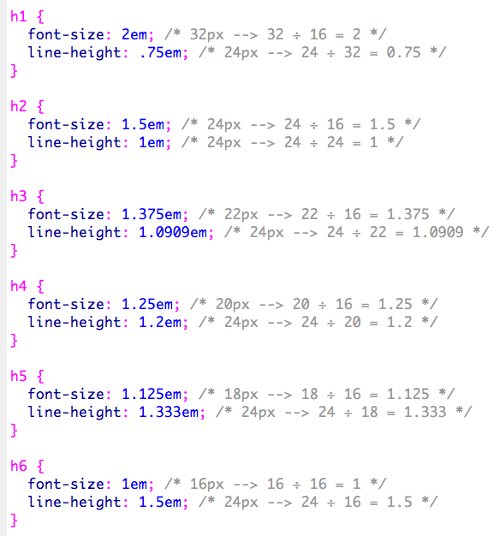
Once we know the size of the type, we have to determine the line height. To do that we take the target line height and divide it by the size of the type. For example, our h1 elements are 32 pixels. We divide that by 24 to get 0.75em line height.

Slide 13
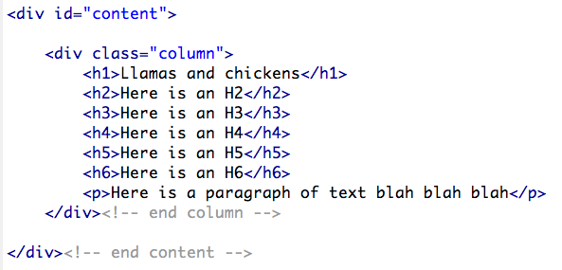
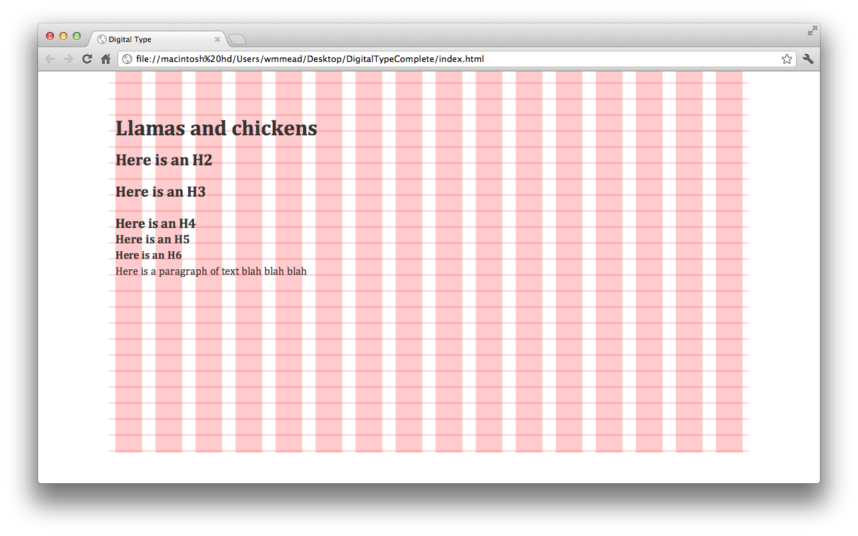
Let's test it out!
For reasons I don't really understand, the larger elements don't sit properly on the lines, but the important thing is that the paragraph text does.

Slide 14
If you really want to get the positioning just right, a little bit of relative positioning can get the errant headers in line.
I set the top to -0.2 em for the h1s and h2s. I set it to -0.1em for the h3s and h4s.
Ok let's get some real content on the page.

Slide 15
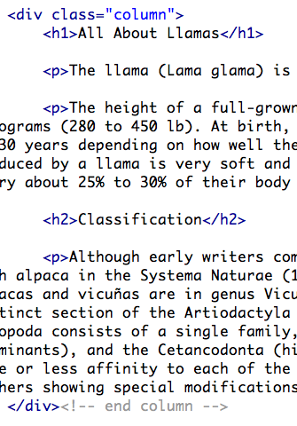
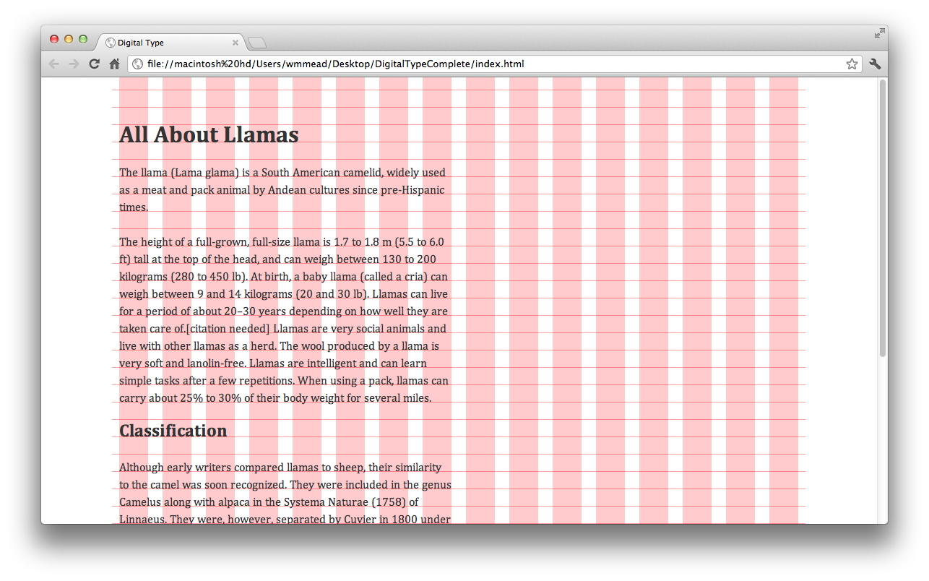
Let's add some content about Llamas.

Slide 16
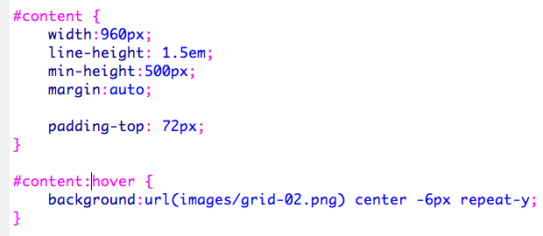
The grid is getting in the way of seeing our work now. So I added this rule and moved the background image for the grid in there. Now it only shows when we hover over the #content div.

Slide 17
We can create an intro paragraph with some special sizing.
Images can be a pain in baseline grid layouts, but if we just float them left or right and let the text wrap around them, it usually works out pretty well. Notice I set up the width of the picture to fill three columns exactly.

Slide 18
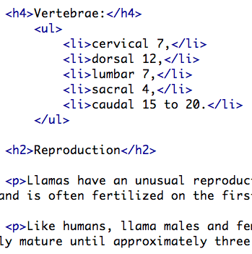
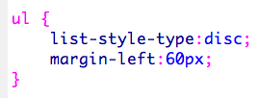
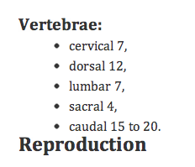
Let's add some more content, including a list, which will need some styling as well.
We can add UL's to the rule that puts margin on the bottom of elements.

Slide 19
Notice the use of the nicer curly quotes down at the bottom of the page compared to the straight ones we are using at the top of the page.
We can use HTML entities to get those characters to look right. This can be done for lots of special characters to give your text a nicer look and feel.

Slide 20
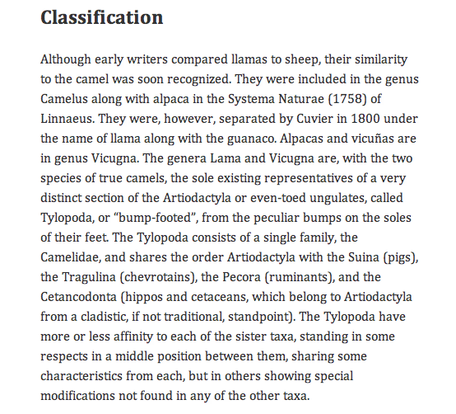
We know that technically, we want to avoid rivers weird gaps in our text. The ragged edge on the right should look good, or if we want to justify the text we need to beware of these visual problems that crop up.
Here is a cool thing to try. Use this hyphenator JavaScript to break up words and add hyphens automatically.
It can be found here:
http://code.google.com/p/hyphenator/
We will hook it up in a really simple way to try it out, but if you check out the documentation, there is a lot of functionality in this script.

Slide 21
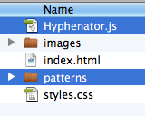
I have already downloaded and included the files we need, so all we have to do is hook it up and and initialize it.
At the top of the page, inform us what language the site is in and then add the class hyphenate to the column.

Slide 22
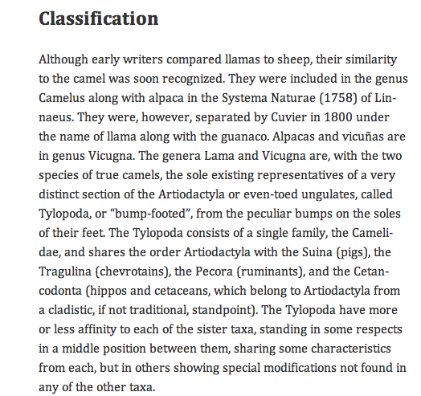
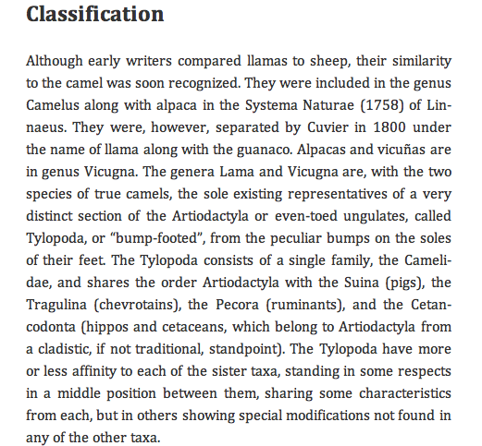
Before and After. Pretty cool eh?
Justified looks good too.

Slide 23
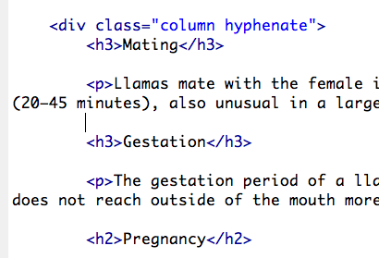
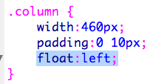
This is another interesting rule to try out. It will indent all but the first paragraphs.
Let's add a second column to round out our design.

Slide 24
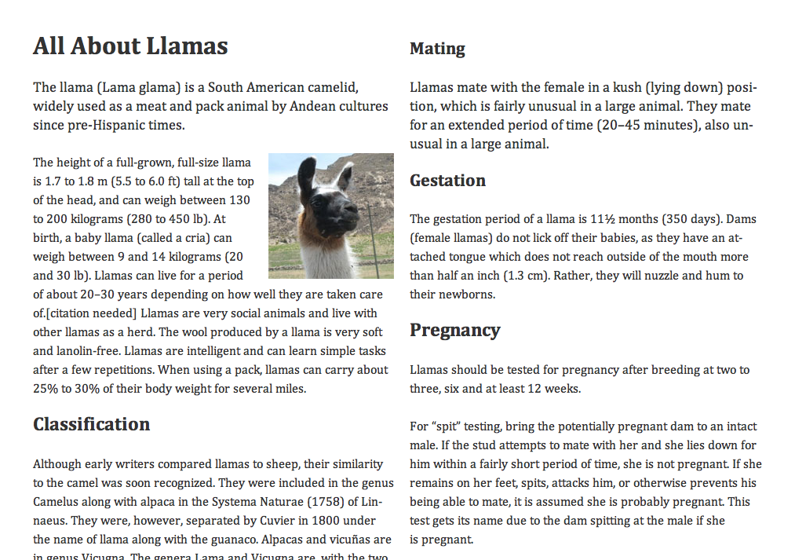
It works, but there are a couple of things I want to fix. First, our roll over for our grid is not working correctly any more. We need to make the #content contain it's floated elements.
Secondly, the first paragraph of this second column should be lower on the page I think. Also it starts with the intro text, which I don't really want.
I added this just below the reset script. It will make elements contain their floats.

Slide 25
Next, I gave the first paragraph on the page a class and changed the rule that makes the text larger for the intro paragraph to that class.
Then I added a class called second to the second column and a rule that pushes it down two more grid sections on the page.

Slide 26
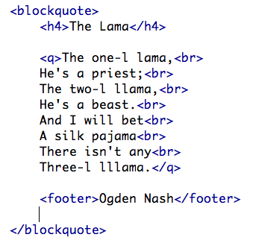
The last thing to point out is the HTML at the bottom of the page. The proper way to mark up this blockquote is going to be a topic of discussion for some time in the web world, but this is currently not uncommon.

Slide 27
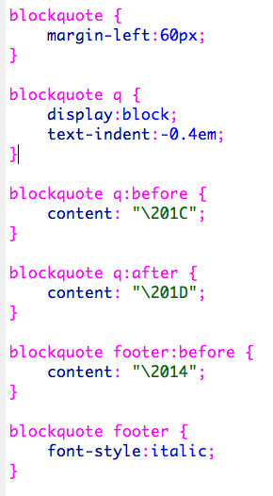
This is an interesting set of rules. Notice the markup has no quotes or the mdash at the bottom.
Sometimes it is appropriate to take these elements out of the markup. This is the case when they are there for decorative purposes and do not add meaning to the content.
This may not be the appropriate time for it, but I wanted to show you the technique.

