Slide 1
CSS Sprites Part 1

Slide 2
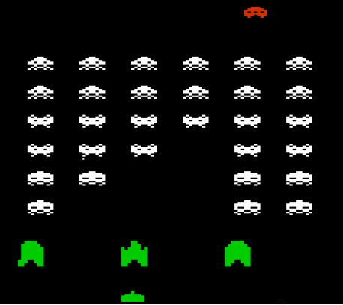
What are sprites?
In the early days of video games, memory for graphics was very low.
So to make things load quickly and make graphics look like they were moving, several graphics were included in one image file.
You could show only a portion of the image on the screen at any time.
These were called sprites.
Why use sprites in web design? Two reasons: first, since only one image is loaded, there is zero wait time to get the alternate image. Secondly, it requires only one trip to the web server, which will help optimize the loading speed of the web site.

Slide 3
OK, lets get started.
On this page, we had two images to make this navigation work. Lets combine these two images into one and use it as a sprite.
Open the two button graphics in Photoshop. Zoom into them about 1200%

Slide 4
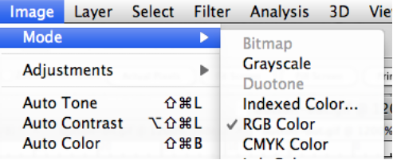
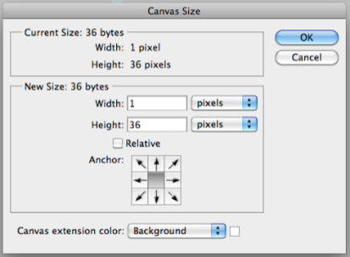
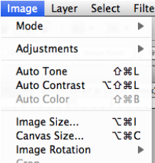
These are currently GIF images. Convert them back to RGB Color images by going to Image Menu and choosing Mode -> RGB Color
Select all on button-out.gif and copy it.
Go to button-on.gif and then go to Image Menu and choose Canvas Size
We are going to double the height, which would be 72 pixels.

Slide 5
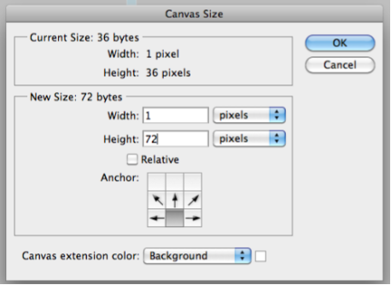
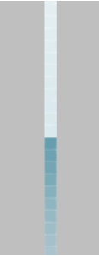
Set it to 72 pixels and set the anchor to the bottom center.
This will add white pixels above our bottom graphic.
Paste in the pixels from the button-off.gif
Position it so it is fully above the button-on.gif graphic.
Use Save for web, and save this new image as button.gif

Slide 6
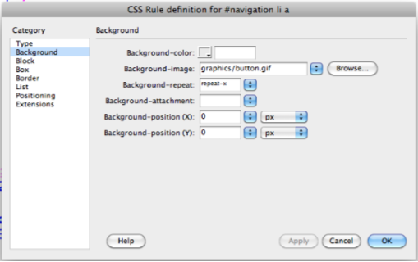
Now we just have to change our CSS a little.
For our #navigation li a rule we change the background image to be our new button.gif image and set the background position to be zero pixels for both X and Y
Since the height is only 36 pixels, it will only show the first 36 pixels of the background image.

Slide 7
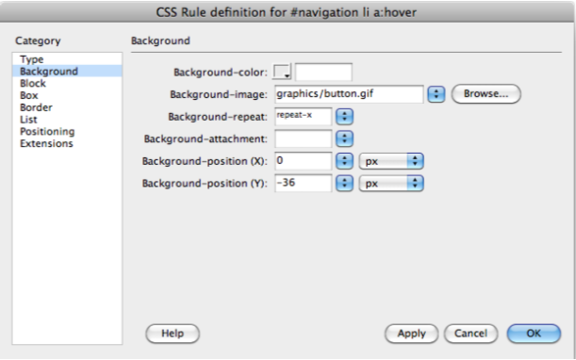
For the hover rule, we background image to button.gif also, and set the position for Y to -36px. That will move the image up 36 pixels and start it at that point.

Slide 8
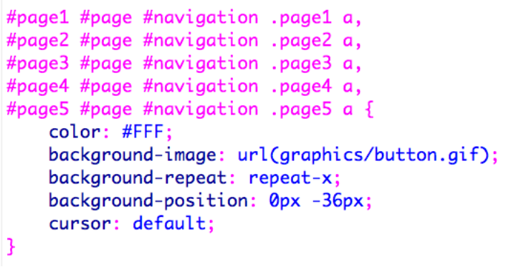
We should fix this rule too, as shown above. However, lets push it a little further. Instead of just using our hover image for the current page, lets make an additional gradient.

Slide 9
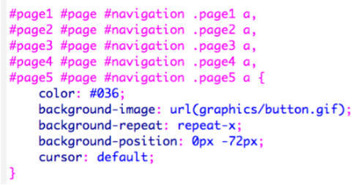
I added an additional 36 pixels to the bottom of the image, and pasted in the gradient I used for the over state, then went to Image -> Adjustments -> hue saturation and played with the colors until I got this yellow color. You can pick something different if you want.
Re-save the button.gif replacing the old one, and then fix the current page rule so that it starts at -72 pixels for the Y axis. I also changed the text color so it will stand out on the yellow.
There we have it. Sprites for everyone!

