Slide 1
CSS Sprites

Slide 2
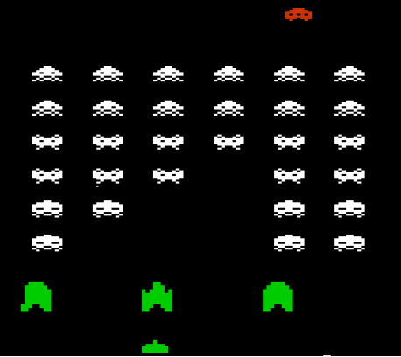
What are sprites?
In the early days of video games, memory for graphics was very low.
So to make things load quickly and make graphics look like they were moving, several graphics were included in one image file.
You could show only a portion of the image on the screen at any time.
These were called sprites.
Why use sprites in web design? Two reasons: first, since only one image is loaded, there is zero wait time to get the alternate image. Secondly, it requires only one trip to the web server, which will help optimize the loading speed of the web site.

Slide 3
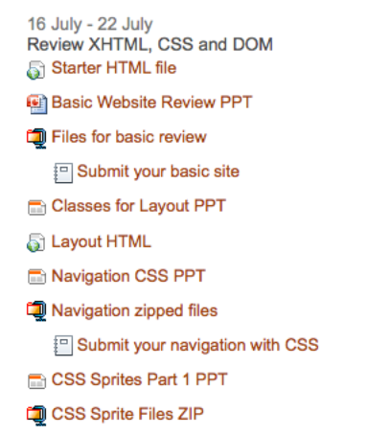
There are lots of places where you can imagine using sprites. Bill Mead’s website, www.meadpoint.net/learn, has a lot of icons and motion effects.
This site uses Moodle, an open source content management system for education. You might imagine all these icons are part of a sprite, but I was surprised to see that they are not! Each is a separate little image.
What if we wanted to use these icons for another site, but wanted to make a sprite?

Slide 4
I downloaded a folder of icons from the server that is used by the theme for all of these icons on the site. There were 58 of them in the folder.
You can imagine building a Photoshop file with all of these icons, spaced properly, and keeping track of all the positions for 58 icons would be a LOT of work.
Thankfully, there are some FREE tools that will reduce the amount of work a huge amount.
Download the zipped icons. You can unzip them to look at them if you want, but we will actually want the zipped file.

Slide 5
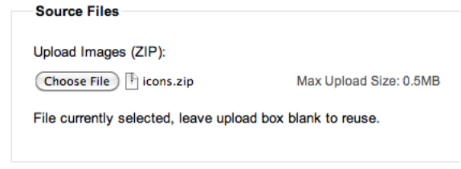
Next, we will visit this site: http://spritegen.website-performance.org/
You can experiment with all of the various settings later. For right now follow along with these settings:
First, choose the folder with all of our icons in it. Notice there is a maximum size of 1MB (now, but 0.5 when this screenshot was grabbed). That will be important for some situations.

Slide 6
I am going to leave all the other settings as default with the exception of these two. I am going to uncheck Wrap columns to fix Opera bug for now (in the Sprite Output Options section)
I am also going to uncheck Display width and height in the CSS Output Options.
Then click the button at the bottom of the page.

Slide 7
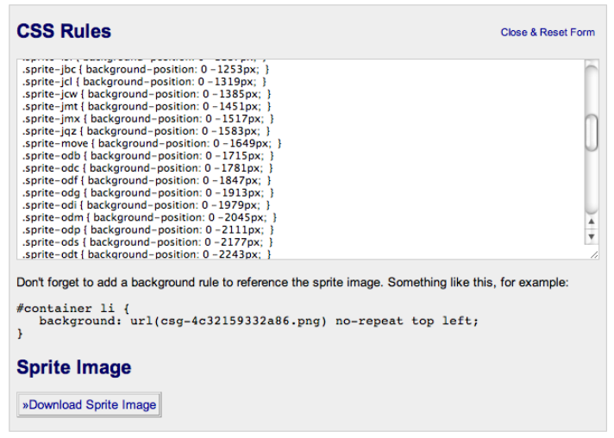
The page will reload and pop up at the top will be this box. Go ahead and download the sprite image, and also select and copy all the rules in the dialog box above. Your CSS and Image have been created for you! Now we just have to figure out how to use it!

Slide 8
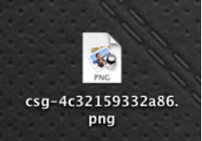
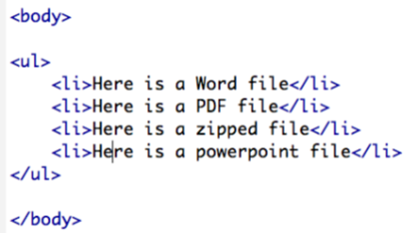
On your desktop (or in your download folder) you will have this image with all your icons inside of it.
Put it in a folder on your desktop and then start up Dreamweaver, make a new HTML file and save that into the folder as well.
Lets just add a simple unordered list onto the html file.

Slide 9
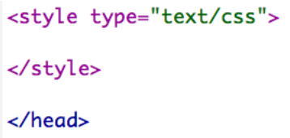
Add some style tags before the </head> tag closes. Go ahead and paste in all the styles created by the sprite generator.
The sprite generator site has this reminder. So go ahead and copy this rule and put it in your CSS.

Slide 10
We are currently not using a container div, so I just changed it to ul li. Also, that file name is stupid. It will take me about ten minutes to forget what that is referring to, so I am going to change it to mysprites.png
Don't forget to change the name of the actual graphic file as well.

Slide 11
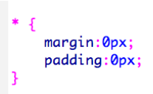
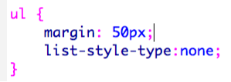
Lets add a few more rules. At the top of my stylesheet I add my basic reset rule to get rid of any extraneous margins and padding.
Add a rule for the UL that will set some specific margins for the whole block and remove the bullets.
Finally, we add to the rule for ul li. Just add some padding on the left, set the line height and some margin on the bottom.

Slide 12
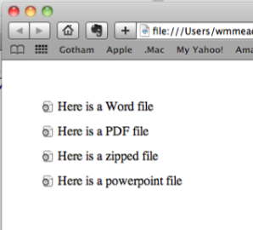
If you test the file now, you will notice you get the first icon in the sprite every time. How do we get the correct icon for each list item?
Easy! we just use the classes generated by the sprite generator.
By putting the correct class on each list item, we can display the correct icon.

Slide 13
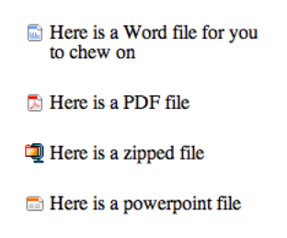
Here are these four done. Notice you can set the margin between the list items to whatever you want and they will display properly.
Here I set the width of the UL to 200px and made the text wrap. There is 25px between list items.
Here is another tutorial that does this in a similar way with paragraphs:
http://websitetips.com/articles/css/sprites/

