Slide 1
Intro to Responsive Web Design
Build sites that respond to the user's viewing device

Slide 2
Many websites have a fixed width layout, and as we are learning to work with HTML and CSS, this is a good place to start.
However, some websites have been traditionally built on a more flexible structure that makes use of the full browser width.

Slide 3
My Yahoo is a good example. Many of the portal type sites will use a full page width approach. Notice that in this case, only the center column changes it's width.

Slide 4
These sites are usually set with a minimum width, below that, you get a scroll bar on the bottom.
There has been a group of web designers that advocate letting content be flexible and stretch and fill the browser window as necessary.
The problem with this approach is that the relationships between pieces of content and the sizing of elements in the design can break.
This can be confusing to the user and impede the way the site communicates at different screen sizes.

Slide 5
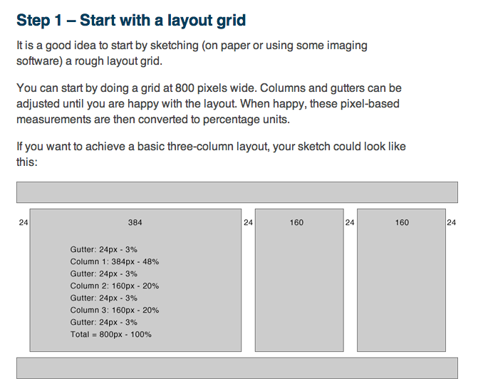
For a while, liquid layouts were all the rage, but they never really caught on. Why?
Because they were difficult to code, and often elements such as images would not cooperate.
Here is an article from way back in 2003 that discusses the process of setting up a liquid grid layout.
http://www.maxdesign.com.au/articles/liquid/

Slide 6
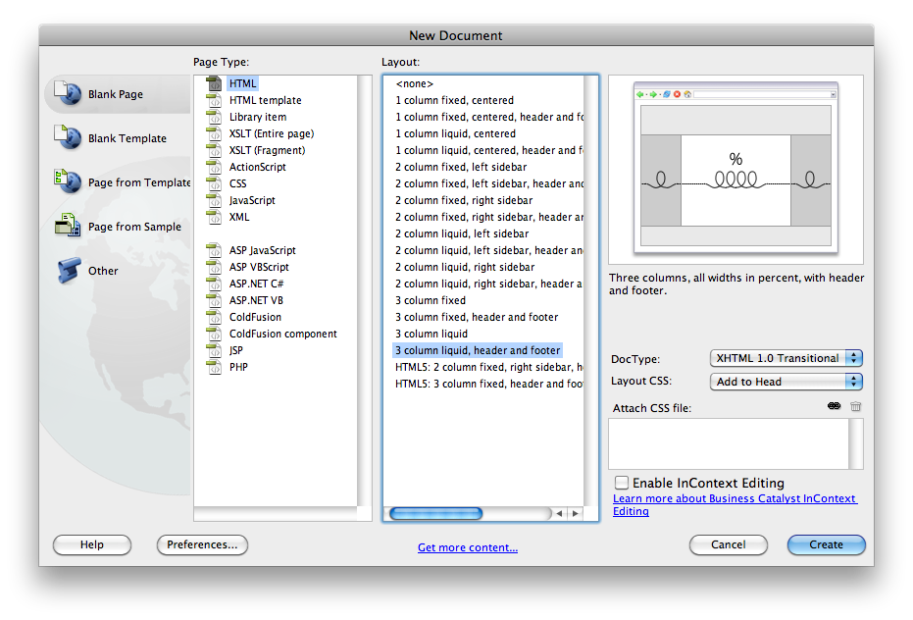
Dreamweaver used to have templates to create this type of layout, but they were terrible and difficult to work with. They have been removed from the most recent versions of Dreamweaver.

Slide 7
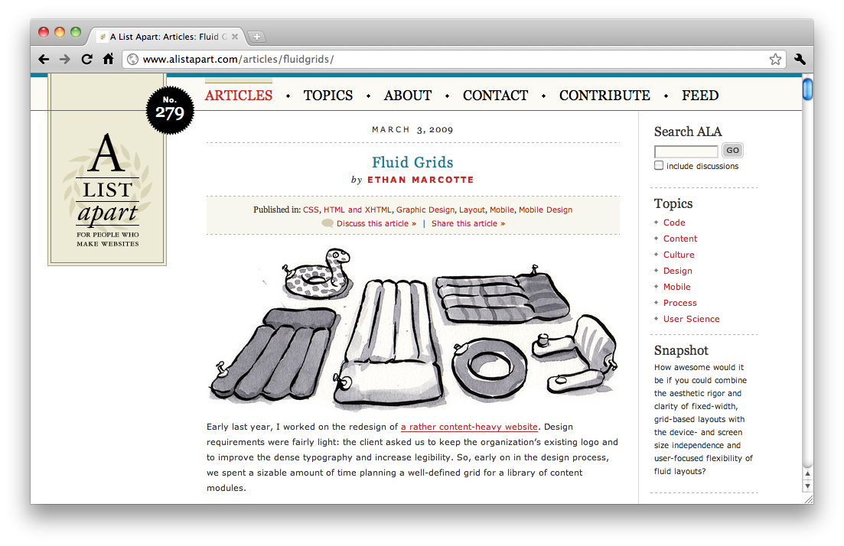
Web designers, not being people to give up easily, continued to look for ways to achieve the balance between flexibility and control.
http://www.alistapart.com/articles/fluidgrids/
In 2009, a full year before he wrote his famous article about responsive design, Ethan Marcotte wrote this article about flexible grids. The idea of creating a flexible grid is really a forerunner to the now widely touted idea of "responsive web design".

Slide 8
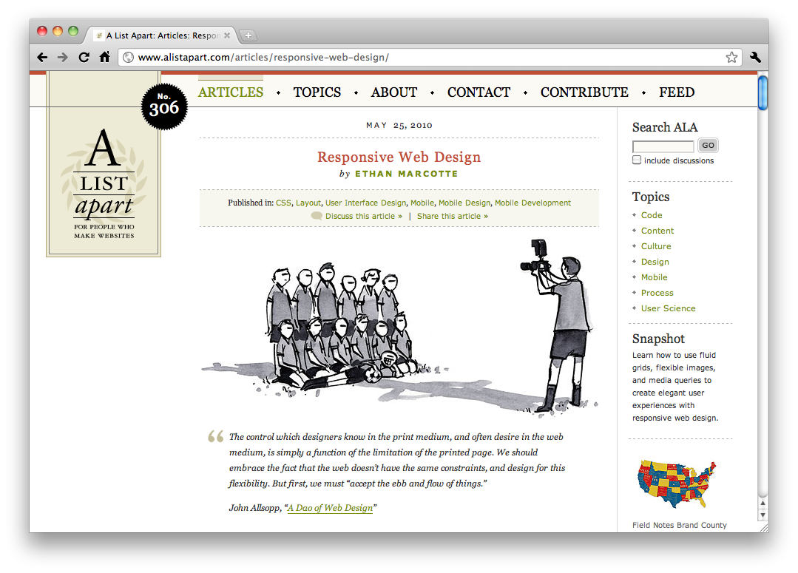
In 2010 Marcotte wrote the article that launched Responsive Web Design. With the advent of many more devices with different sized screens, and the advent of CSS3 media queries both the need for flexibility and the tools to get it are here.
http://www.alistapart.com/articles/responsive-web-design/

Slide 9
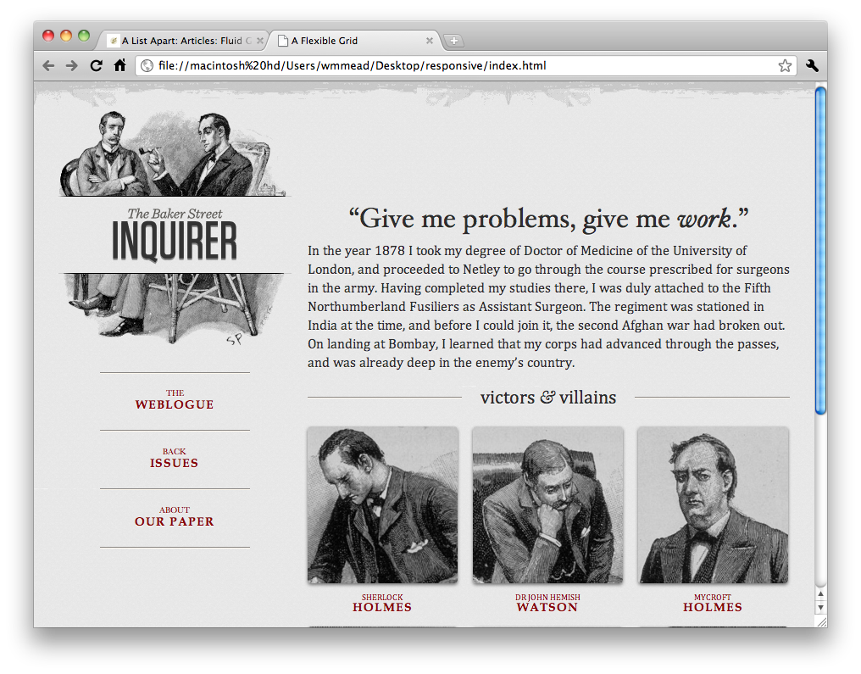
You can check out the final version of Marcotte’s example here:
http://d.alistapart.com/responsive-web-design/ex/ex-site-FINAL.html

Slide 10
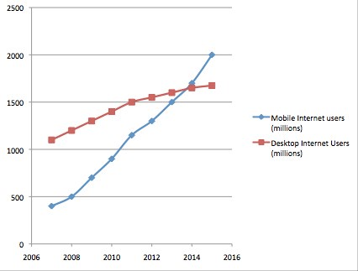
Since 2010 or 2011, responsive design has become very important in web design. There has been a lot of development and best practices are still developing in this area.
In 2013, mobile users of the web surpassed desktop users of the web. We ignore them at our peril.

Slide 11
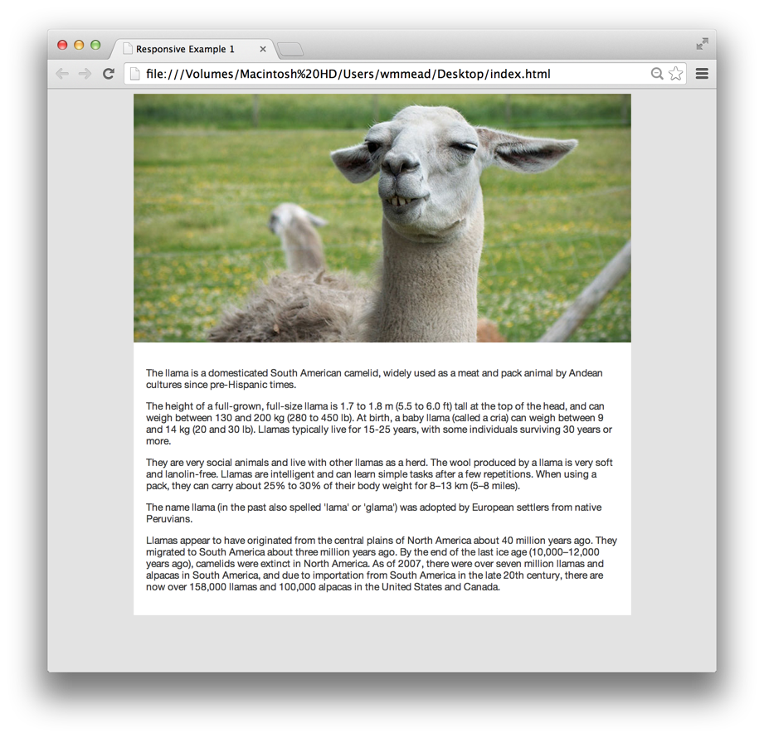
Inspite of all the work done on responsive design in the past few years, there are still a number of challenges associated with it. Some of these challenges are technical, and some of them are oriented more towards design.
Let’s take a quick look at one of the more egregious examples.
Here we have a simple fixed width layout. The div with ID “page” is set to 800px wide, and margin is set to auto so that the div displays in the middle of the browser window.
The image is 800px by 400px and fits perfectly.

Slide 12
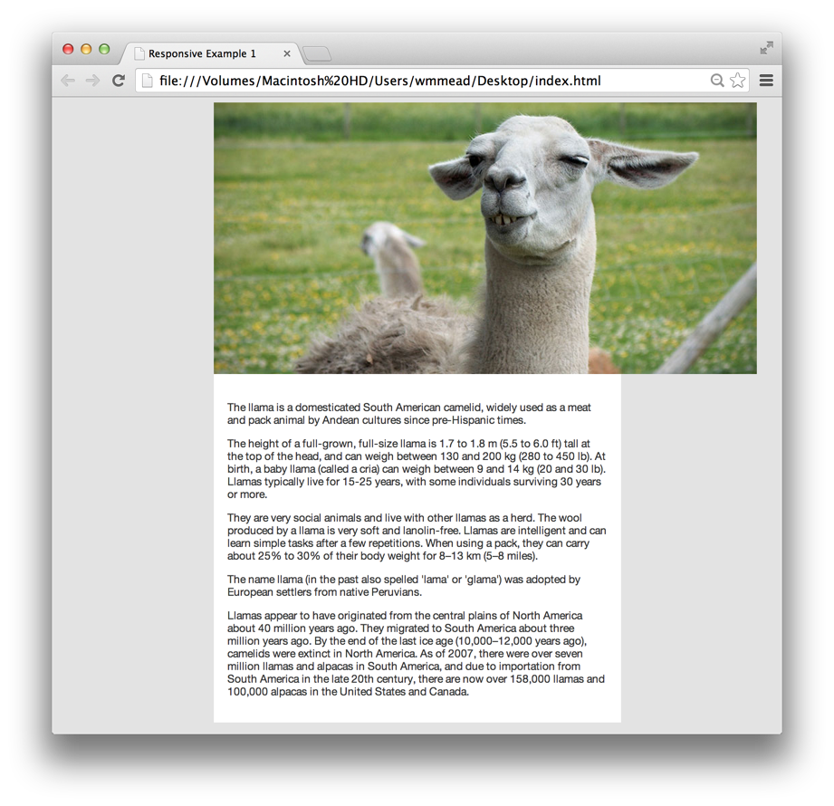
What happens if we change the width of that page to 600px?
The image is now breaking out of the container, and ruining the layout.

Slide 13
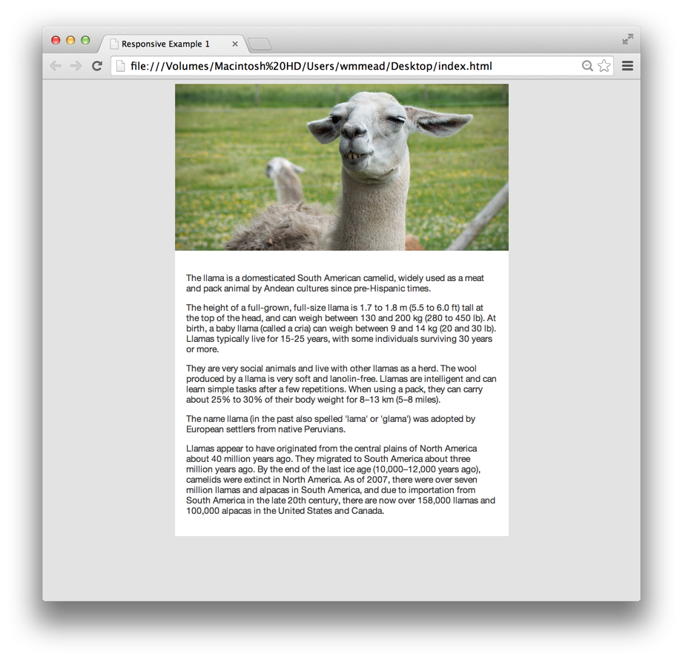
We can address this with this little rule...

Slide 14
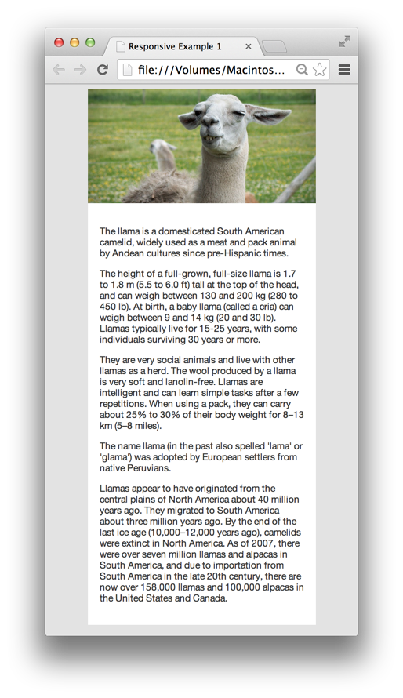
What if we go even further and make the page truly flexible?
You can see that we could easily accomplish a mobile layout. However, there is a big problem here.
The image we are downloading is really 800px wide. If we check the specifications of the image, we can see that it is about 60k in size.
We are using the browser to size it down visually, but the user still has to download the big image.

Slide 15
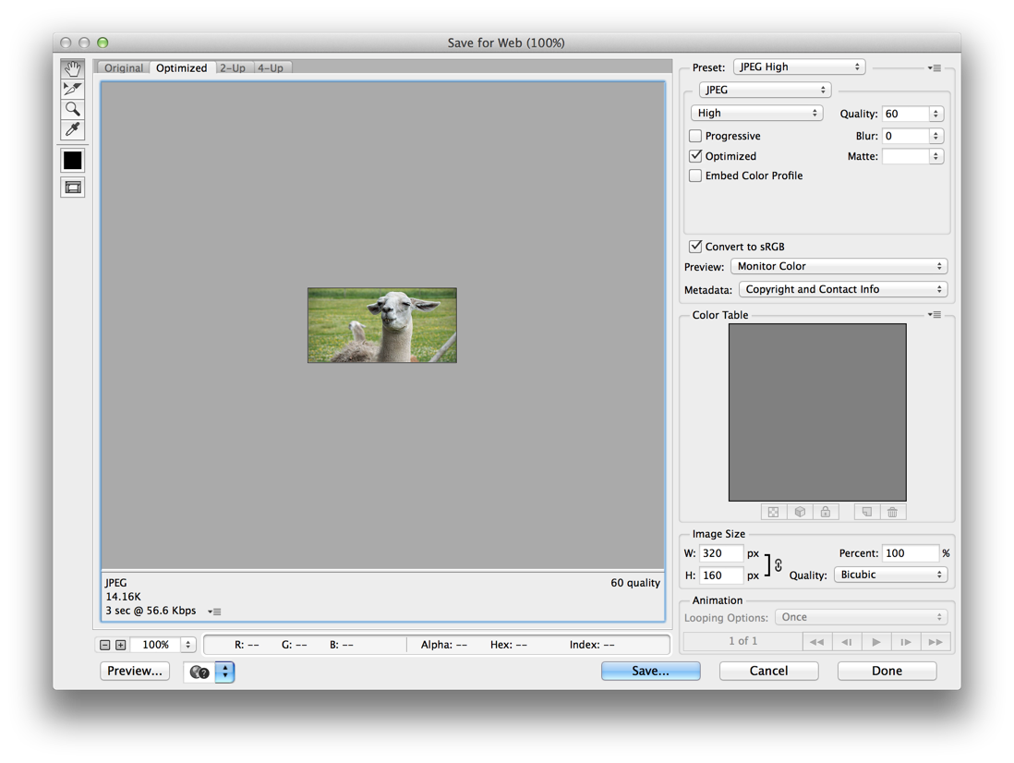
If I were to go into Photoshop and size the image down to 320px, I can easily get it down to 14k, however, with current responsive techniques, we are forcing mobile users, who are often on slower networks, to download a 60k image. This is just one example of the kinds of technical issues we are dealing with.

Slide 16
Down the road, we will be seeing better ways of addressing these types of issues. Currently working its way through the specification process is the <picture> element, which will allow you to specify different files for different screen sizes.
Here is an article: http://html5hub.com/html5-picture-element/
The current methods and techniques used to create responsive websites are not that hard to master, but every technique comes with advantages and disadvantages. The tougher problem is figuring out which techniques to use in a given situation.

