Slide 1
Basic Responsive Design Techniques

Slide 2
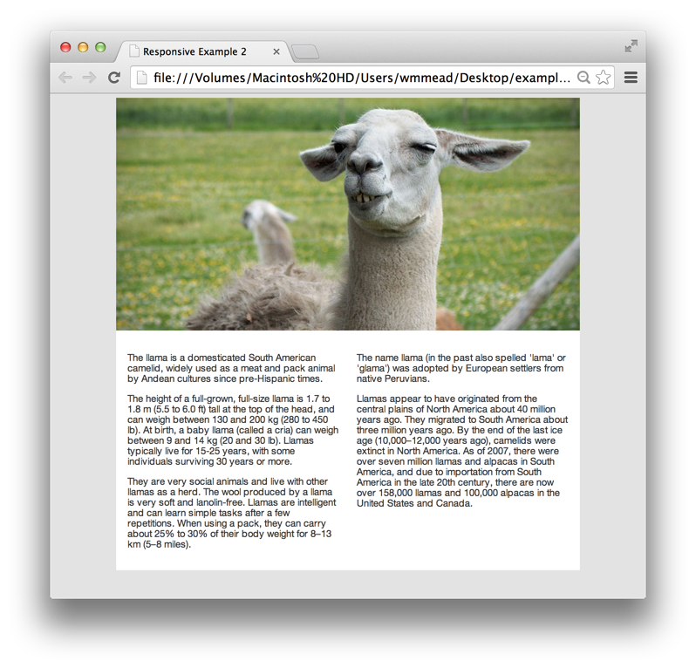
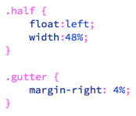
Let’s take a look at this basic layout. It has a header and two columns of text, in a box that is centered on the screen.
The two columns are in divs that float left and are 48% wide. There is 4% gutter (right side margin) on the first div.
Overflow:hidden is set on the article containing the two columns, because we want it to contain the two floated elements. You should be pretty familiar with this technique by now.

Slide 3
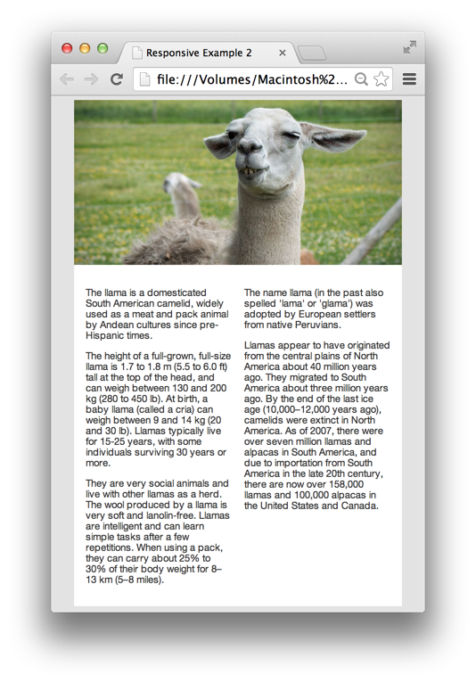
Setting widths of elements as percentages, rather than specific pixel widths is the key to creating flexible grids.
media queries are the key to most of responsive design.
If you add the code above to the bottom of your stylesheet, it will make the #page element 90% as wide as the screen, if the screen is less than 800 pixels wide.
If you size the browser window down, you will see the page container pop into place when you get to less than 800 pixels.

Slide 4
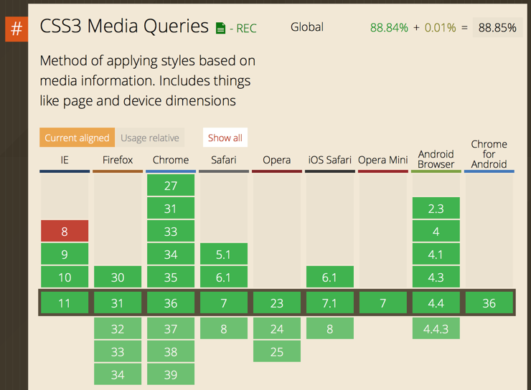
Media queries are part of CSS3, and are not supported by old browsers.
However, since the purpose of using them is to make websites work properly on mobile devices, and none of the mobile devices are running IE8 or older, it is a non-issue.
Also note, that media queries introduce conditional coding into CSS for the first time...
(If this is true, apply this rule…)

Slide 5
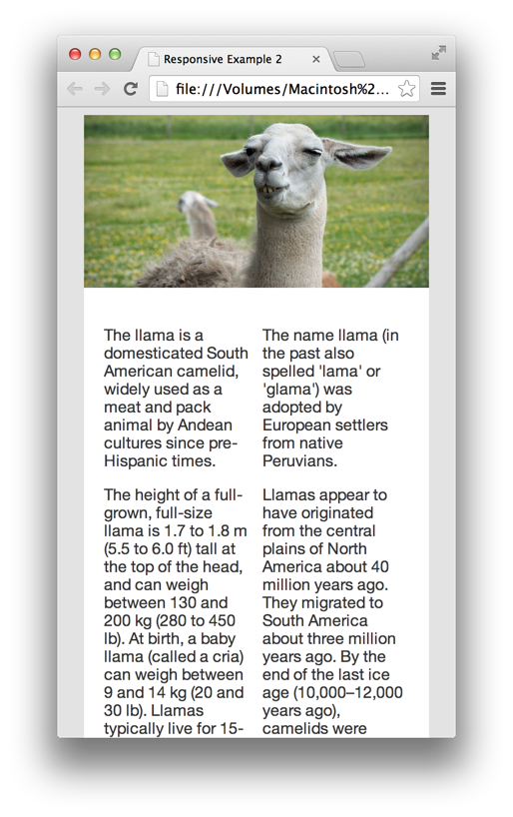
Media queries are particularly useful when the layout starts to break because the percentage widths no longer make sense.
If you make this page narrow enough, then two columns just don’t work.
If we add this media query at the bottom, it will remove the float from the columns, making one long column, and get rid of the space for the gutter, if the screen is less than 500px wide.

Slide 6
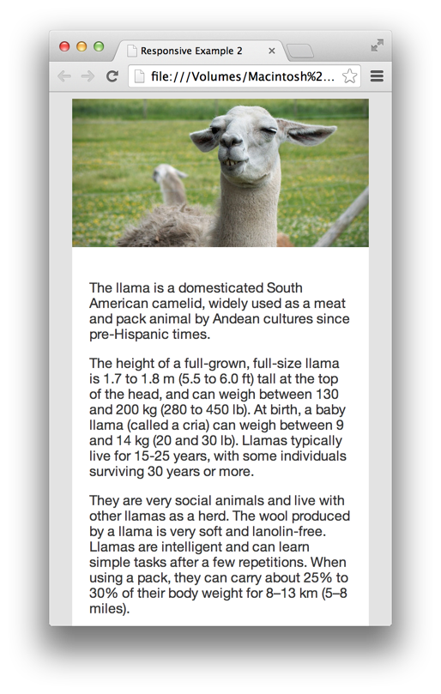
Now, at a small screen size, we have a one column layout that is easy to read.
Media queries can be used in all sorts of creative ways to adjust layouts so that they make sense for different screen sizes.
However, working with percentages for widths of everything can be a pain. What if, for example, we want to put a border around those two columns?
Notice what happens if we put a 5 pixel border around each column...

Slide 7
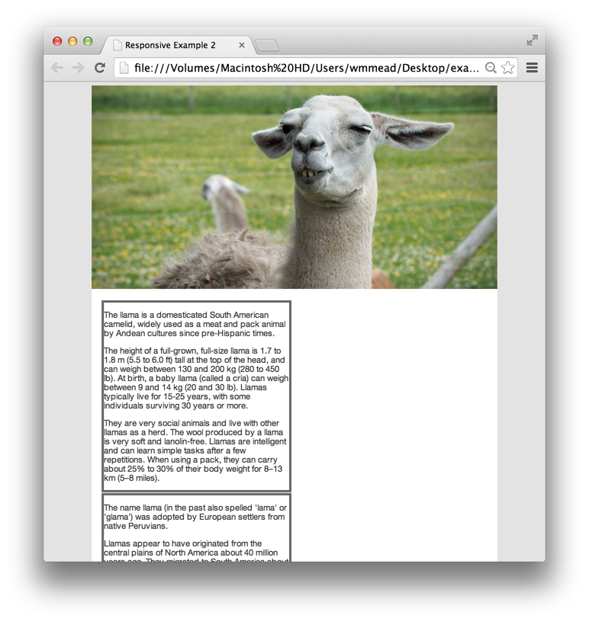
We have lost our two column layout entirely. This is because our two columns are 48% wide with a 4% gutter. That totals 100%.
Adding the border adds to the width, but that puts us over 100%, and now the column is wrapping down.
I could subtract from the 48%, but how much would I subtract? Mixing different types of units becomes really tricky.
I could set the border width as a percent, but that could look really dumb at some sizes.
and if I want to get padding in there, it gets even worse.
So what can you do?

Slide 8
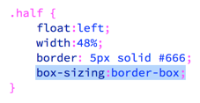
If we add this box-sizing declaration and set it to border-box, it changes the default box model for this element.
Normally, padding, border and margin add to the width of any given box (block level element). This effectively changes the model to what it should have been to begin with. Now the width will include the padding and the border, but margin is outside.
Defined width
Margin
Here is the content inside the box. Blah blah blah blah blah blah blah blah blah blah blah blah blah blah blah blah blah blah blah blah blah blah blah blah blah
Border
Padding
Content

Slide 9
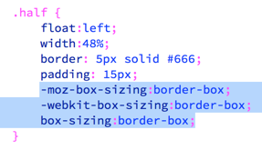
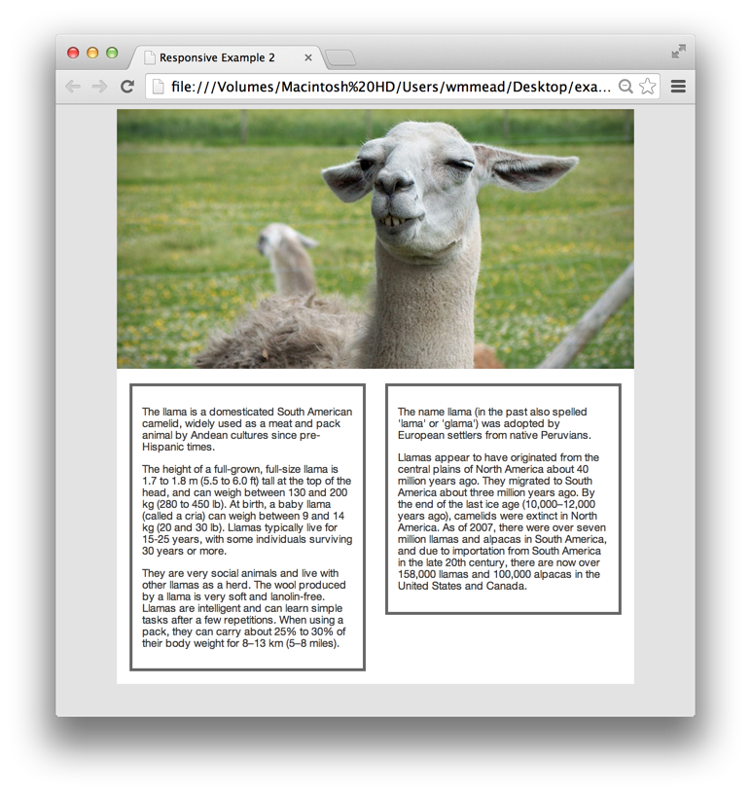
Now I can go ahead and add padding and borders in pixels if I want.
Note that the box-sizing property is part of CSS3 and won’t work on older browsers.
You only have to go a few versions back in Firefox to need the prefix, so I recommend adding them.

Slide 10
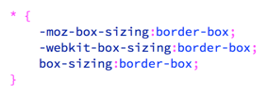
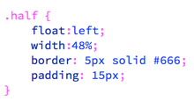
This box-sizing declaration is so useful, many designers are simply changing the box model for all elements on the page with a rule like this. You can put this at the top of your stylesheet, or even inside the reset script and all elements will change their box model.
Then I can remove it from my .half rule.
Please note that you should be careful with this technique. It is not recommended that you go back through old sites and add it, as it can really mess up relationships between elements on those pages that were designed with the old box model.

Slide 11
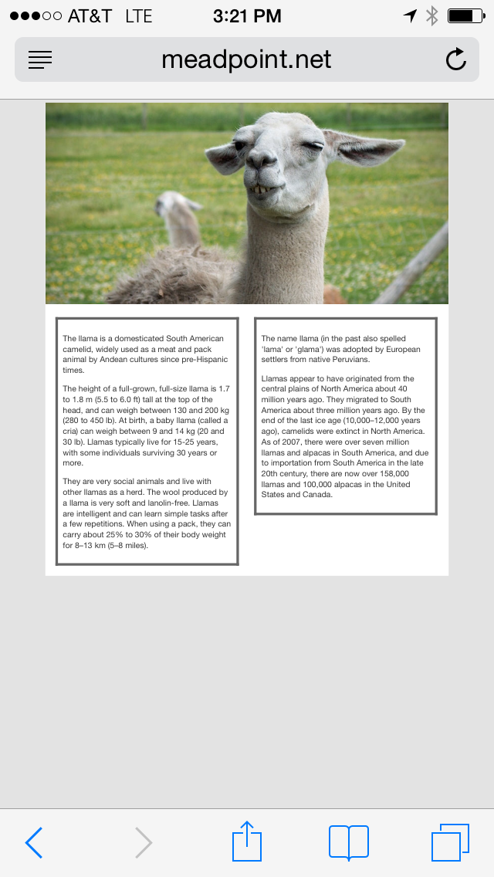
Now, before we get too excited about all this, we need something else to make it work properly on our mobile devices.
Here is what it would look like right now if you were to access it on your mobile phone. How come it is showing the full width version?
By default, the mobile browsers zoom out, and show the whole page, making all our careful work for small screens for nothing. Luckily, there is an easy fix.
Add this meta-tag in the <head> of your document and it will force the browser to not zoom out.

Slide 12
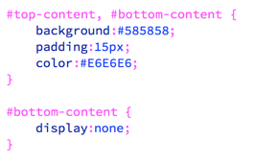
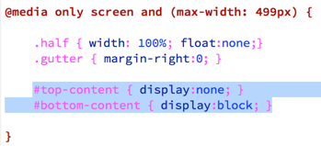
Next, I am going to add this div to the top of the page, and another one at the bottom of the page. Notice they have unique ID’s
Then I will add these two rules to the stylesheet (before the media queries at the bottom). Notice, the bottom one will be hidden by default.
Then, inside the media query, I will add these two rules, essentially hiding the top content and showing the bottom content on small screen sizes.

Slide 13
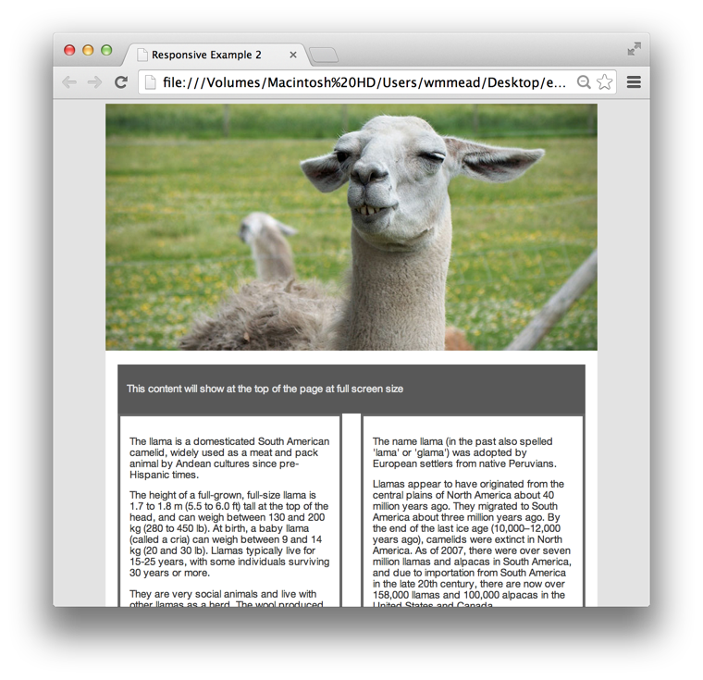
When the screen is full size, you see the content at the top; when the screen is small, you see the content at the bottom.
You can imagine that this can be useful when the hierarchy of a page needs to change for the mobile version, however, it comes at a cost.
Both the content in the top AND bottom are being downloaded for every browser, even though the user will not even see one of them.
In this case, we are just talking a about a few bytes of information, but if there are images, it could be a lot more.
You can see this page for yourself at example2
There is plenty more to get into, but setting max-width on images, working with media queries, using percentages for widths, and changing the box model for elements are the major techniques used in responsive web design. Just keep in mind the performance issues that come along with these techniques.

